Slide 1
Path Planning Methods for USVs
Sajjad Edalatzadeh
Mitacs Postdoctoral Fellow

Slide 2
Schematic of a USV

Slide 3
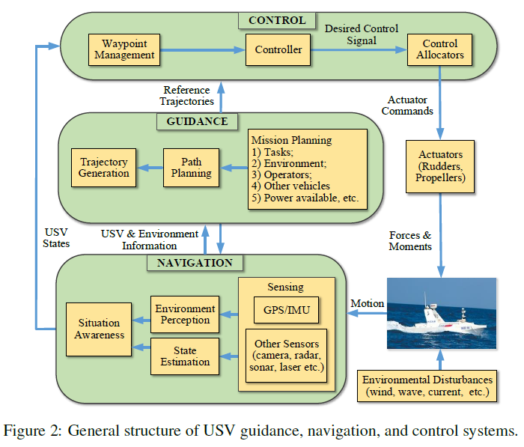
GNC Modules

Slide 4
Path planning methods
Global path planning
Heuristic search algorithms
Optimization-based methods
Local path planning
Line-of-sight methods
Potential fields

Slide 5
Global vs Local path planning
Different types of obstacles are present in marine environment:

Slide 6
Classic search algorithms
There are several classic search algorithms used in computer science:
Depth First Search (DFS)
Breadth First Search (BFS)

Slide 7
Heuristic search algorithms
A heuristic algorithm works with an estimate of the cost of a path traversing point p.
n
g(n) exact cost
h(n) heuristic estimate of remaining cost
start
goal

Slide 8
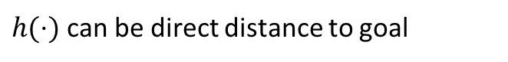
Heuristic search algorithms
A* Algorithm (Hart et al. 1965):
$h(⋅)$ can be direct distance to goal

Slide 9
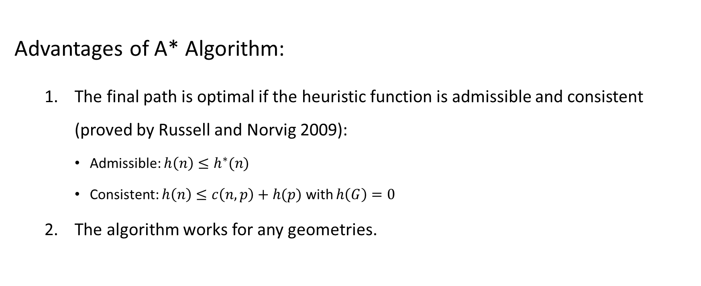
Heuristic search algorithms
Advantages of A* Algorithm:
The final path is optimal if the heuristic function is admissible and consistent (proved by Russell and Norvig 2009):
Admissible: $h\left(n\right)≤h^{∗}(n)$
Consistent: $h\left(n\right)≤c\left(n,p\right)+h(p)$ with $h\left(G\right)=0$
The algorithm works for any geometries.

Slide 10
Heuristic search algorithms
If tie-breaking coefficient is larger than one, the path may not be optimal; however, this path may be faster to find.

Slide 11
Heuristic search algorithms:
Disadvantage of A* algorithm:
Times consuming
Memory inefficient
Not intelligent

Slide 12
Heuristic search algorithm:
Relaxed A* Algorithm (Ammar 2015):
The final path is not necessary optimal
Better memory use and faster convergence

Slide 13
Optimization-based methods
Genetic Algorithm (Kim et al. 2017):
Chromosomes (optimization parameter) are turning angles:
Fitness function:
Target condition:
Reaching a target objective:

Slide 14
Optimization-based methods
Genetic Algorithm (Kim et al. 2017):
Obstacle avoidance objective:
Least travel-time objective:
Final fitness function:

Slide 15
Optimization-based methods
Ant Colony (Kim et al. 2017):
The algorithm is based on the behavior of ants.
Ants release pheromone as they move.
Other ants follow the area with most pheromone.
We grid the area and assign a probability to each node:
Pheromones are updated using the rule:

Slide 16

Optimization-based methods
Ant Colony (Kim et al. 2017):
Potential fields $η_{ij}$ are added to improve the algorithm.

Slide 17
Optimization-based methods
Ant Colony (Kim et al. 2017):
Obstacle avoidance layers:
Emergency layer (opposite direction)
Accurate layer (visibility graph algorithm)
Fuzzy layer (poor Lidar data to fuzzy controller)

Slide 18
Optimization-based methods
Particle Swarm Optimization (Roberge et al. 2012):
The algorithm is based on migration of birds.
Originally used for UAVs.
It used the location, velocity, best past individual experience, and best past group experience.
The update formula is according to:

Slide 19
Optimization-based methods
Particle Swarm Optimization (Roberge et al. 2012):
The cost to be optimized consists of

Slide 20
Local path planning
Fast Marching Method:
Fast Marching Method was first used to solve the propagation of magnetic waves (Sethian 1996).
The method was later used to find the minimum path for fiber cables between cities.

Slide 21
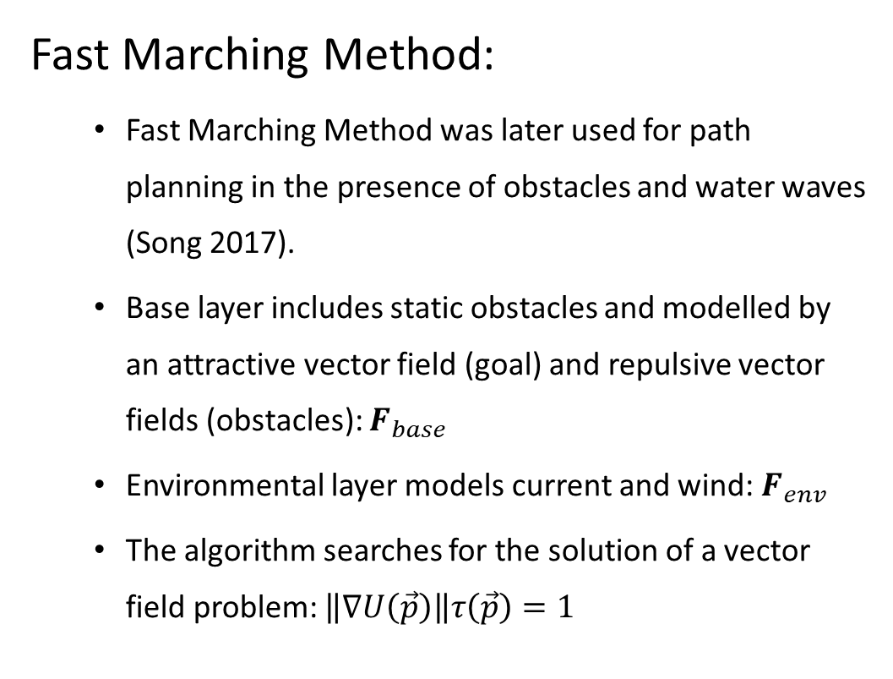
Local path planning
Fast Marching Method:
Fast Marching Method was later used for path planning in the presence of obstacles and water waves (Song 2017).
Base layer includes static obstacles and modelled by an attractive vector field (goal) and repulsive vector fields (obstacles): $F_{base}$
Environmental layer models current and wind: $F_{env}$
The algorithm searches for the solution of a vector field problem: $\left\|∇U\left(\vec{p}\right)\right\|τ\left(\vec{p}\right)=1$

Slide 22
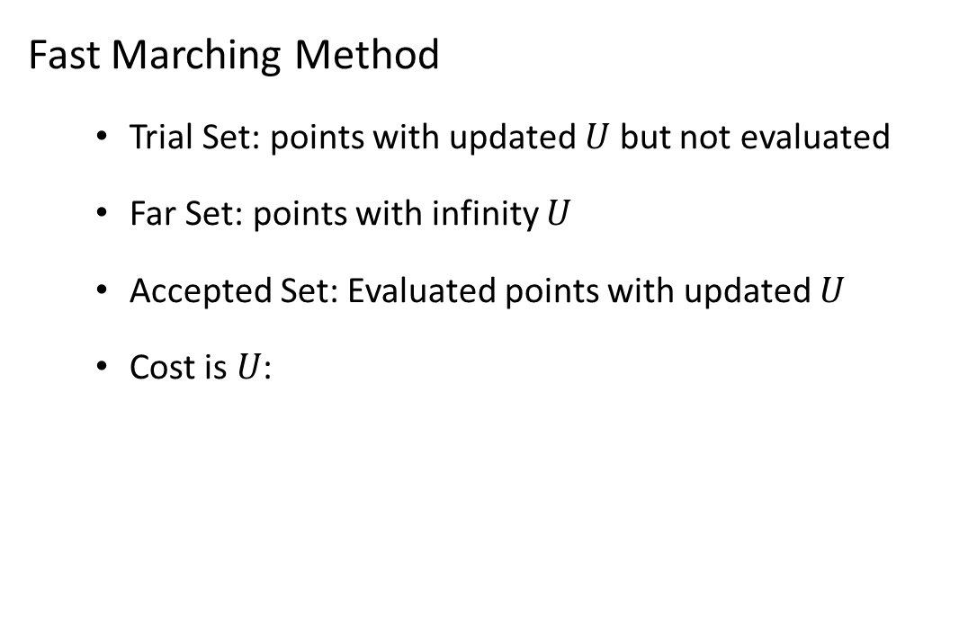
Local path planning
Fast Marching Method
Trial Set: points with updated $U$ but not evaluated
Far Set: points with infinity $U$
Accepted Set: Evaluated points with updated $U$
Cost is $U$:

Slide 23
Local path planning
Fast Marching Method

Slide 24
Local path planning
Advantages of Fast Marching Method
Obstacle avoidance
Influence of water current and wind
Dynamic obstacle, current, and wind
Versatile for all geometries

Slide 25
What to do next
Creating a simple virtual environment with static and dynamic obstacles
Applying the methods to find various paths
Finding the optimal path
Applying control for trajectory tracking

